Slide 1
Welcome to the Sacramento District presentation of Know Your Rights.
KNOW YOUR RIGHTS, KNOW THEIR RIGHTS
Training for Immigrant Allies in Churches
CONOZCA SUS DERECHOS - CONOZCA LOS DERECHOS DE ELLOS
Formación para Aliados de los Inmigrantes en Iglesias

Slide 2
In this presentation we will cover:
Knowing your rights
Immigrant rights
Video Scenarios
What can you do…
        Churches
        Individuals
Resources
Questions

Slide 3
KNOW YOUR RIGHTS
CONOZCA SUS DERECHOS

Slide 4
FOURTH AMENDMENT
CUARTA ENMIENDA
Prohibition against unreasonable search and seizures.
Prohibición de registros
e incautaciones irrazonables.

Slide 5
PUBLIC V. PRIVATE SPACES
ESPACIOS PUBLICOS VS. PRIVADOS
Public Spaces
Anyone can enter
ICE can enter w/out explicit consent
Examples:
  Parking lots
  Lobbies
  Waiting areas
  Places of business open to the general public.
Espacios Públicos
Cualquiera puede entrar
ICE puede entrar sin consentimiento explícito
Ejemplos:
  Estacionamientos,
  Vestíbulos
  Zonas de espera
  Locales comerciales abiertos al público en general.

Slide 6
PUBLIC V. PRIVATE SPACES
ESPACIOS PUBLICOS VS. PRIVADOS
Private Spaces
Not open to the general public
ICE needs a warrant or explicit consent
Examples:
  Staff Areas
  Locked Spaces
Explicitly private spaces are better than implied private spaces
Espacios Privados
No abiertos al público en general
ICE necesita una orden judicial o consentimiento explícito
Ejemplos:
  Zonas destinadas al personal
  Espacios cerrados con llave
Los espacios explícitamente privados son mejores que los espacios implícitamente privados

Slide 7
Private Spaces
NO Entry without a warrant
NO Entry without consent
Espacios privados
NO entrada sin orden judicial
NO entrada sin consentimiento

Slide 8
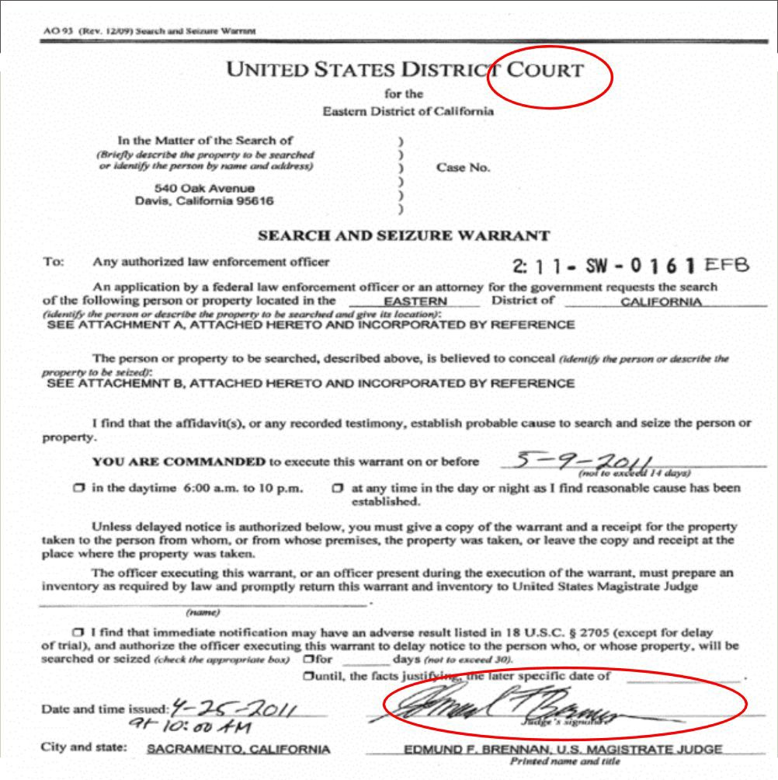

Check for the signature. The warrant is not valid without a judge's signature.

Slide 9
REASONS ICE MAY COME TO YOUR CHURCH/WORKPLACE
MOTIVOS POR LOS QUE ICE PUEDE VISITAR SU IGLESIA
Raids / redadas
Targeted Enforcement / aplicación selectiva
I-9 Audit / auditoría I-9
  Requires a written notice / Requiere una notiﬁcación por escrito
  Requires 3 business days to respond / Requiere un plazo de respuesta de al menos 3 días laborables

Slide 10
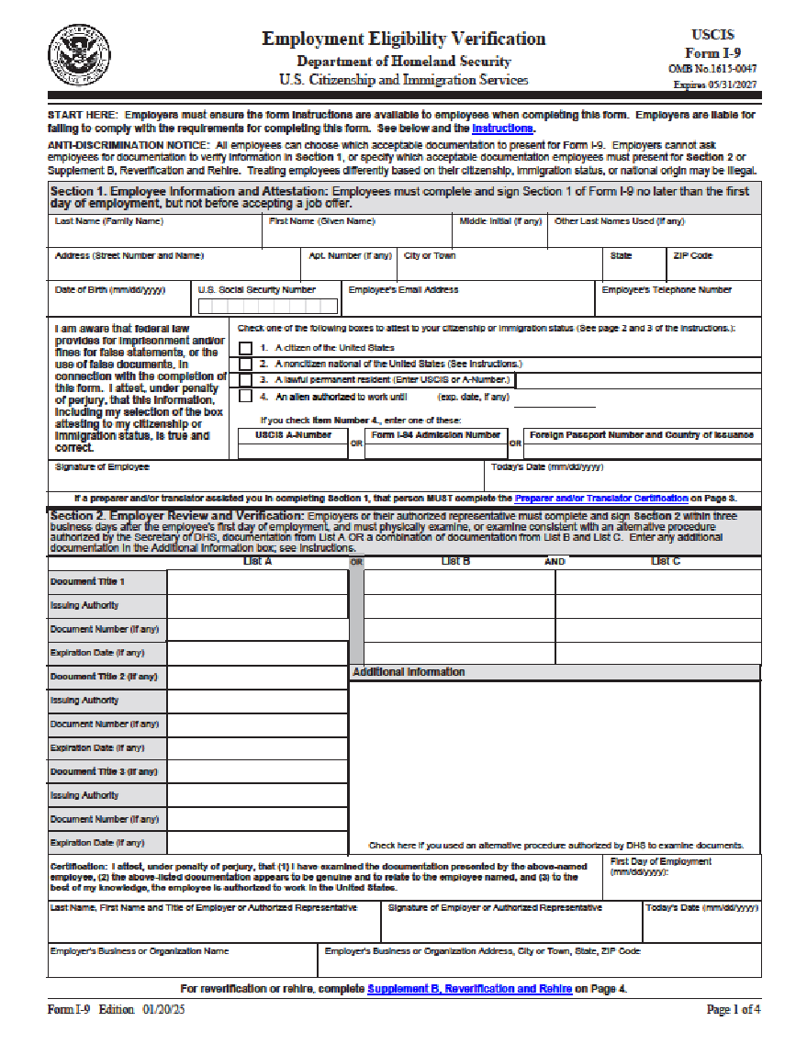
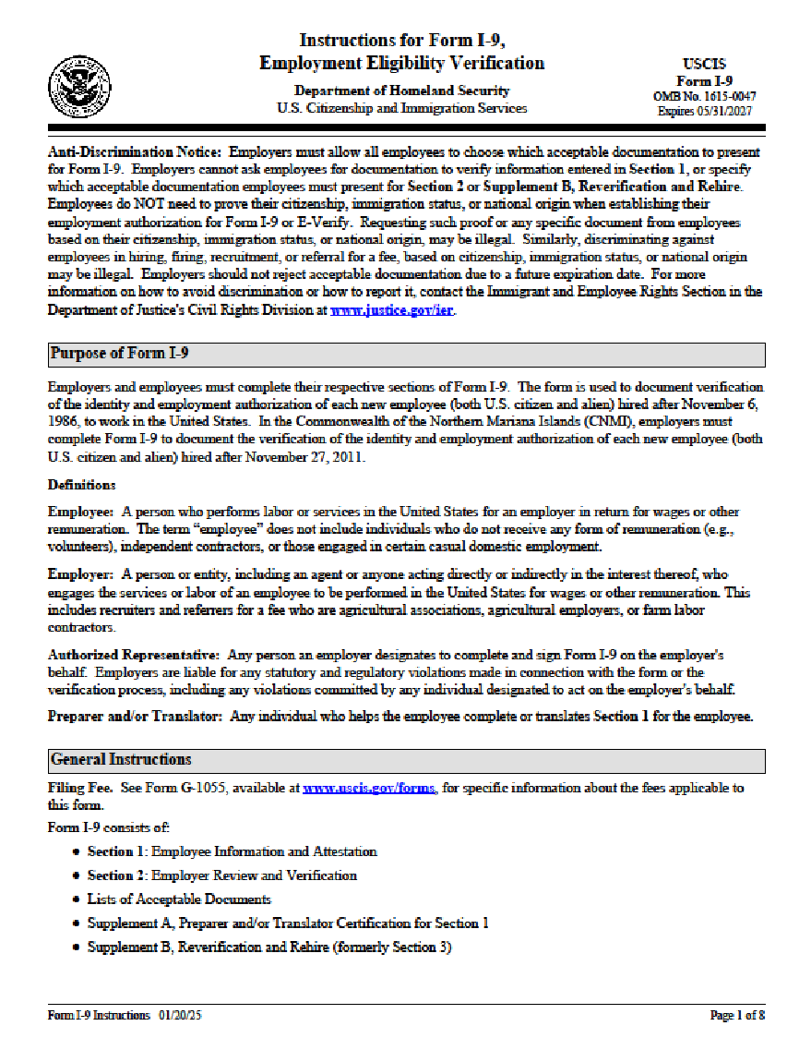

Slide 11
IMMIGRANT RIGHTS
DERECHOS DE INMIGRANTES

Slide 12
ADVISING IMMIGRANTS
ACONSEJANDO A INMIGRANTES
Each immigrant’s case is different
Individual advice needed
General advice can be given: Maximize chances of not being detained after an encounter
El caso de cada inmigrante es diferente
Se necesita asesoramiento individual
Se puede brindar asesoramiento general:
Maximizar las posibilidades de no ser detenido después de un encuentro.

Slide 13
RIGHT TO REMAIN SILENT
DERECHO A PERMANECER SILENCIO
Miranda Rights
  Anything you say can and will be used against you
Don’t speak
  “Silence is golden”
“Am I Being Detained?”
No - Walk Away
Yes - “I want to speak to an attorney”
Derechos Miranda
  Todo lo que digas puede y será usado en tu contra
No hables
  "El silencio es oro"
“¿Estoy detenido?”
  No - Aléjate
  Sí - "Quiero hablar con un abogado"

Slide 14
NO CONSENT
NO CONSIENTA
Don’t Consent
  “Just Say No”
Let ICE ﬁgure out the warrant
  Can we Come in?
    No
  Can we see your ID?
    No
  Can we ask you some questions?
    No
No consienta
  "Di no"
Dejen que ICE se preocupe por la orden judicial
  ¿Podemos entrar?
    No
  ¿Podemos ver su identiﬁcación?
    No
  ¿Podemos hacerle algunas preguntas?
    No

Slide 15
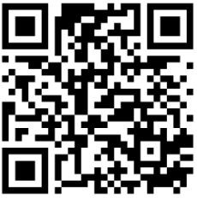
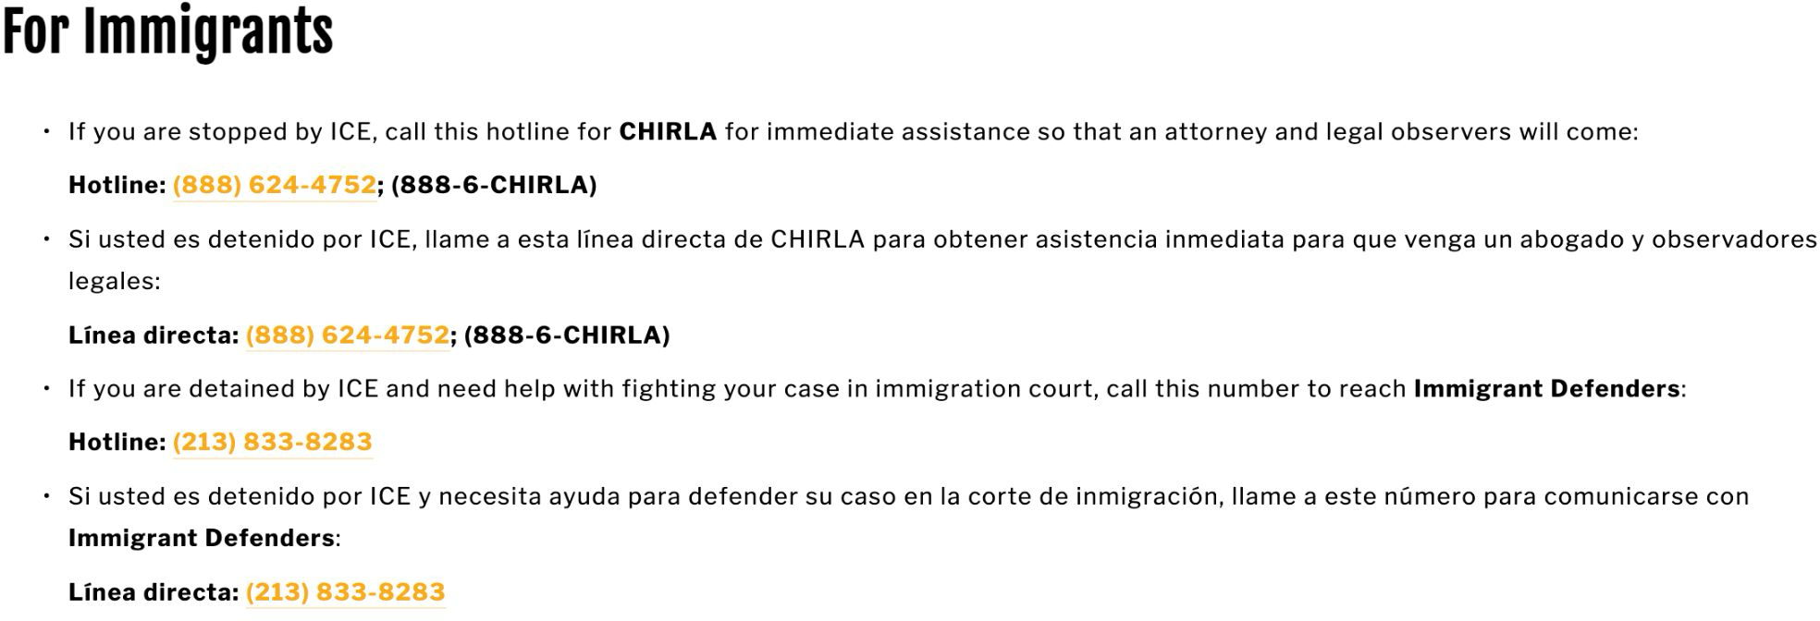
KNOW YOUR RIGHTS - Resources to Share
CONOCE TUS DERECHOS - Recursos para compartir
www.IRCSGV.org “You Have Rights - What To Do If You Encounter ICE”

Slide 16
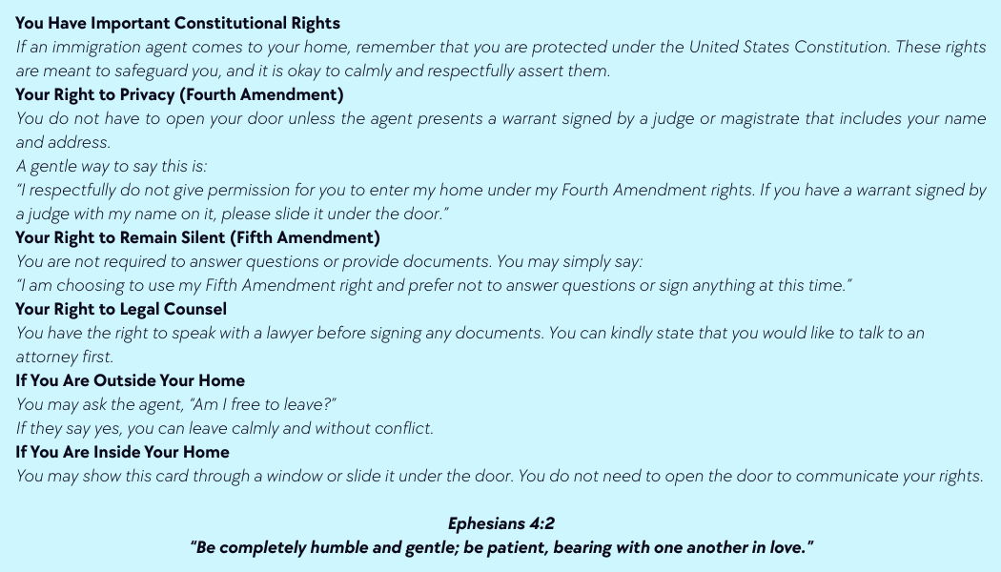
KNOW YOUR RIGHTS - Resources to Share
CONOCE TUS DERECHOS - Recursos para compartir
Sacramento District Blue Card

Slide 17
WHAT CAN YOU DO?
CHURCHES
¿QUÉ PUEDES HACER?
IGLESIAS

Slide 18
WHAT CAN CHURCHES/BUSINESSES DO?
¿QUÉ PUEDE HACER LAS IGLESIOS/LOS NEGOCIOS?
1. Written Policy
1. Politica escrita

Slide 19
Best Practice - Follow AB 450
Without a warrant, employers MAY NOT
  Consent to ICE entering private spaces
  Provide employee private information to ICE
Subject to ﬁnes and penalties
Ongoing litigation - currently halted by courts
Buenas prácticas - Seguir la AB 450
Sin una orden judicial, los empleadores NO PUEDEN
  Consentir al ICE para que entre en espacios privados
  Proporcionar información privada de los empleados al ICE
Sujeto a multas y sanciones
Litigio en curso - actualmente suspendido por los tribunales

Slide 20
WHAT CAN YOU DO?
¿QUÉ PUEDES HACER?
Written Policy
Designated person or team
Politica escrita
Designar a una persona/equipo

Slide 21
WHAT CAN YOU DO?
¿QUÉ PUEDES HACER?
Written Policy
Designated person or team
Document Everything
Politica escrita
Designar a una persona/equipo
Documente todo

Slide 22
WHAT CAN YOU DO?
¿QUÉ PUEDES HACER?
Written Policy
Designated person or team
Document Everything
Don’t Consent - Revoke Access
  “I’m sorry, I’m not authorized to help you. Can you wait outside while I contact my supervisor?”
Politica escrita
Designar a una persona/equipo
Documente todo
No consiente nada - revoque el acceso
  "Lo siento, no estoy autorizado a ayudarle. ¿Puede esperar fuera mientras me pongo en contacto con mi supervisor?"

Slide 23
WHAT CAN YOU DO?
¿QUÉ PUEDES HACER?
Written Policy
Designated person or team
Document Everything
Don’t Consent - Revoke Access
  “I’m sorry, I’m not authorized to help you. Can you wait outside while I contact my supervisor?”
Balance Hospitality & Safety
Politica escrita
Designar a una persona/equipo
Documente todo
No consiente nada - revoque el acceso
  "Lo siento, no estoy autorizado a ayudarle.
¿Puede esperar fuera mientras me pongo en contacto con mi supervisor?"
Equilibrio - hospitalidad y seguridad

Slide 24
WHAT CAN YOU DO?
INDIVIDUAL
¿QUÉ PUEDES HACER?
INDIVIDUAL

Slide 25
KNOW YOUR RIGHTS - Resources to Share
CONOCE TUS DERECHOS - Recursos para compartir
Part I: Make a Child Care Plan
Decide What Kind of a Child Care Plan You Want to Put in Place
There are various ways to plan for another adult to care for your child if you are unable to do so. Some of the options, especially for California are:
1. Verbal Agreement: The most informal arrangement is to let another adult know of your wishes for your child and to verbally agree with them that they will carry out your wishes to care for your child if you cannot. The benefit of this is that it is informal and easy – you do not need to complete any forms or legal documents, and such an agreement will not affect your parental rights. The downside of this informal arrangement is that your chosen caregiver will not have legal authority to make medical or school-related decisions on behalf of your child, which would be problematic if you were deported and unable to care for your child for an extended period of time.
2. Caregiver’s Authorization Affidavit (“CAA”): The next option in California is to not only get another adult’s verbal agreement to care for your child in the event you are unable to, but to have that adult complete a Caregiver’s Authorization Affidavit (“CAA”), which allows them to make certain school and medical decisions on behalf of your child. The benefit of this approach is that the CAA can be given to your child’s school or health care provider so that your chosen caregiver can make certain decisions for the child, and it does not affect your parental rights (you still have custody and control of your child). More information about the CAA and a form you can use are included in Part IV of this toolkit. Please note: the included Caregiver’s Authorization Affidavit can only be used in California.
3. Guardianship. The most formal arrangement is to have a court appoint a guardian for your child. The benefit of guardianship is that once someone has been appointed as a guardian by a California Probate Court, that person has full legal and physical custody of your child, meaning they can make decisions on behalf of your child. Please note: When a guardian is appointed, this does not terminate parental rights, but it does suspend them while the guardianship is in place. The drawback of guardianship is that it must be terminated by the Probate Court in order to get your parental rights back. Please note you must file a petition in the Probate Court requesting the court to terminate the guardianship and it is up to the Judge to decide on what the best option for your child is. Keep in mind that in California you cannot grant another person guardianship of your child informally or through a power of attorney – only a state court can do that. However, you can prepare a Form GC-211 to nominate a specific person to be the guardian of your child. The court will then consider Form GC-211 if and when a guardianship petition is filed. You can also make the nomination conditional upon your detention and/or deportation by completing an attachment to the form GC-211 that specifies when the nomination will be effective. Nominating someone else to have legal custody of your child is a serious decision; please connect with a trusted legal services provider to get more information.
A Note on Power of Attorney. A power of attorney is a written document that you can sign to grant another person the authority to act on your behalf in specified ways. For example, a power of attorney may be used to designate another person to handle your finances, make business decisions, use your money to pay your rent or mortgage, use your money to provide for your child, and similar actions. In California, we do not recommend that a power of attorney be used to designate another person to care for your child. While a power of attorney may be a good option in other states, in California, it cannot be used to transfer custody of your children to another person (only a state court can do that).
Write Down Instructions if Your Child Has Any Medical Conditions and /or Takes Any Medications: Make sure to write down any medical conditions or allergies your child has, any medications that your child takes, as well as doctor and health insurance information. Keep a copy of this information in your important documents file. Give a copy to your child’s school and the adult you designate to care for your child. Let your child know where to find this information if you are not around.

Slide 26
PROTECTION AGAINST EXPEDITED REMOVAL
PROTECCIÓN CONTRA LA DEPÓSITO EXPEDITADO
Prepare packet showing 2+ years residence in US
  NO documents showing foreign national status
  Copies with family members
Show the packet only AFTER detention
  Verbally assert that you have been in the US for over 2 years
  Attorney should assert as well and record interaction
Prepara un paquete que demuestre la residencia en EE.UU. durante 2+ años
  NO documentos que demuestren la condición de extranjero
  Copias con los miembros de la familia
Mostrar el paquete sólo DESPUÉS de la detencióna
  Aﬁrmar verbalmente que llevas más de 2 años en EE.UU.
  El abogado debe aﬁrmar también y registrar la interacción

Slide 27
KNOW YOUR RIGHTS
RESOURCES
CONOZCA SUS DERECHOS
RECURSOS

Slide 28
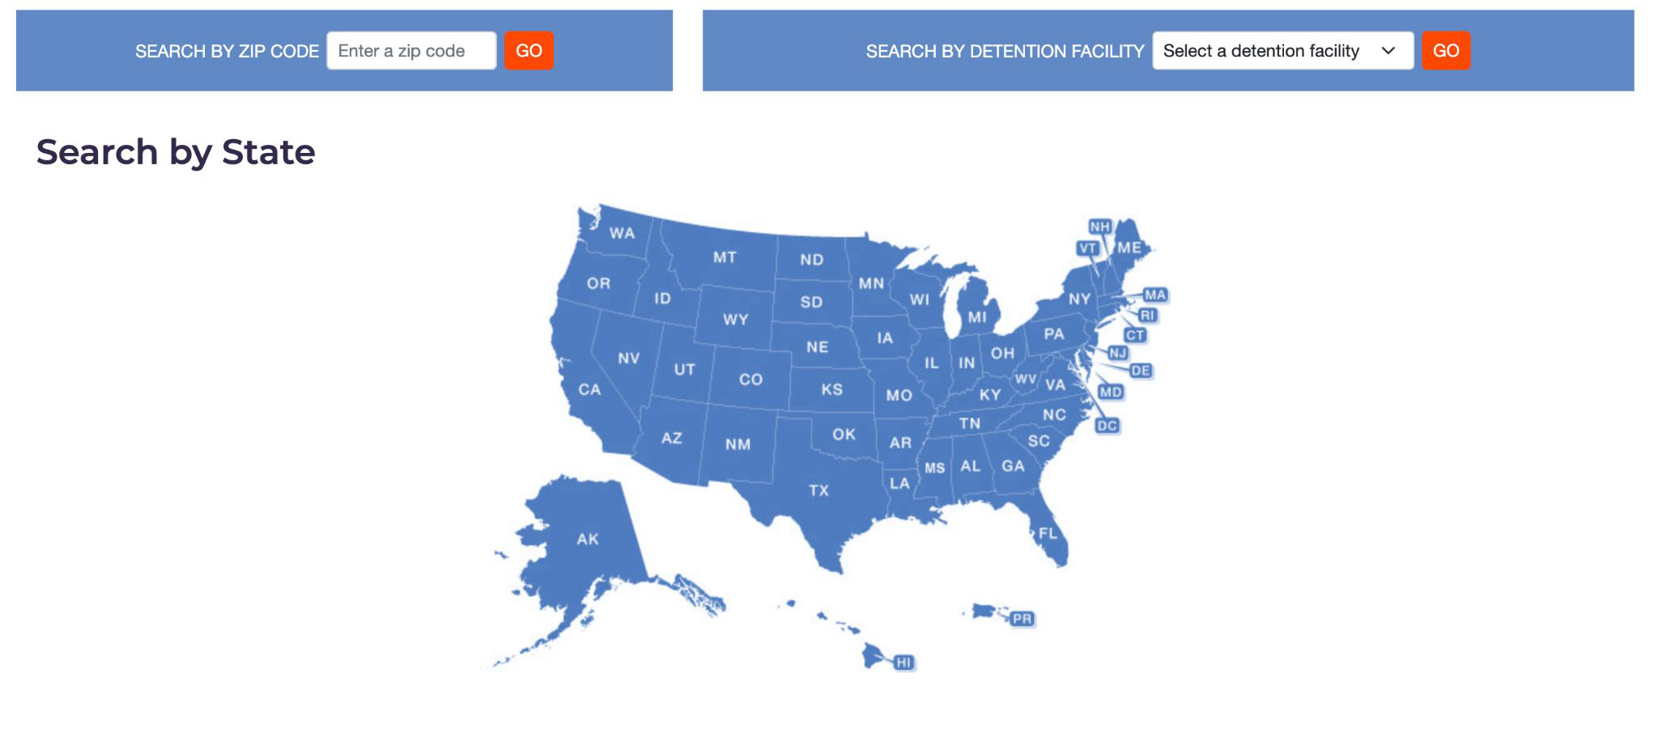
KNOW YOUR RIGHTS - Resources to Share
CONOCE TUS DERECHOS - Recursos para compartir
www.immigrationlawhelp.org

Slide 29
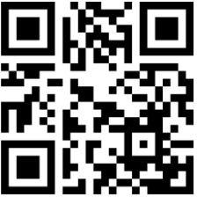
IRC WEBSITE
SITIO WEB DEL IRC
CRITICAL RESOURCES
RECURSOS CRÍTICOS

Slide 30
QUESTIONS?
¿PREGUNTAS?

