Slide 1
Understanding
AB 506
Steps for the Local Church to be in Compliance

Slide 2
What is AB 506/CA Penal Code 11105.3?
Otherwise known as Business & Professions Code 18975
Effective January 1, 2022, all churches in California that have any form of “youth service organization” within their ministries must now adhere to a new three‐step “Standard of Care”.
The first step in the Standard of Care is training their employees who are either mandatory reporters (pastors, church administrators) or employees and volunteers who have direct contact with or supervisory control over children under age of 18.
The second step of the Standard of Care responsibilities is the requirement to have each of these persons fingerprinted via Live Scan as a type of background check.
The third step of the Standard of Care responsibilities is churches must adopt written policies covering the subjects of child abuse and neglect and reporting requirements.
Notes:
They are making changes to this so we need to stay up to date with any changes.

Slide 3


Key Words:
ORI Number:
stands for "Originating Agency Identifier" and is a unique, nine-character code assigned to an authorized organization, essentially identifying the agency requesting the background check when submitting fingerprints for processing.
COR:
“Custodian of Records”, this is an individual within the local church (who should not be the lead/senior pastor) that is responsible for managing, safeguarding, and controlling all official records from the Department of Justice. Expl: board member, administrative assistant, ect.
DOJ:
Department of Justice

Slide 4
What do I do now?
Register as a “Youth Services Organization” with the DOJ to get your ORI number. (You will need your 501-C3 document ready to submit with your application.)
Determine the COR and establish a secure email to receive correspondence from the DOJ.
Start training employees and volunteers.
Write your local church’s policies and procedures.
Prepare Annual Applicant Waivers allowing the release
of state and federal level criminal history information.
*Signed annually
Complete Live Scans for employees and volunteers once
you have received your ORI number.
Tip
Church HR Network is a great tool for policy and procedure templates as well as online training. They provide a certificate and reminders for ongoing training.
Notes:
Getting your ORI is priority number 1, but almost at the same time you need to determine who will be your COR. This is the person who will be taking charge of the next steps and getting the Live Scan information.
You will also need a dedicated file that is only accessed by the COR to house the Live Scan forms and is kept under lock and key.
A regular volunteer that needs a background check if they have direct contact with or supervision of children for more than 16 hour per month or 32 hours per year.
There are so many training options available, you can get training through Ministry Safe, Church HR network, or free through the state. Everyone must go through the training.
Creating policies and procedures might sound daunting but Church HR Network has templates available for you to use for your church so you don’t have to reinvent the wheel.
Church HR Network is a great tool for policy and procedure templates as well as online training. They provide a certificate and reminders for ongoing training.

Slide 5
Church HR Network Membership
Offers the following:
Policies and Procedures in editable form for your church
Training Videos
Can review your ORI application before it is sent to the DOJ to catch any mistakes and answer any questions
On-Call support as well as email support
Assistance for many HR topics such as:
  Recruiting, hiring, and interviewing; Policy and best practices; Crisis management; Dealing with difficult employees; Performance management and so much more.
The District Office has purchased a membership with Church HR Network for every church on our district.

Slide 6
Breakdown of the costs
Start-up costs:
Applying as a “Youth Services Organization” with the DOJ - $79
COR fingerprints as a DOJ submitter (background and rolling fee) - $109
Ongoing costs:
Training fees will vary depending on the method you choose.
Rolling fees paid to the vendor to get a Live Scan - $25-$100
DOJ report including subsequent arrests; fee is waived for volunteers; employees - $32
FBI screening through Live Scan - $17
Notes:
Finding a vendor in your proximity that you can refer your employees and volunteers to, where you have set up a group rate or account with is important. The different vendors charge different prices for the rolling fees.
To live scan a volunteer it would cost about $47 to live scan and employee it will cost about $79
You can set it up with the DOJ where the fees are charged directly to your church.

Slide 7
New in 2024
The DOJ is, for the first time, auditing churches and youth serving organizations for compliance.
While all factors are considered, that majority of the focus is on transparency in screening.
Mismanagement of Live Scan data can result in fines up to $20,000 per violation, per person, per incident.
Notes:
What is transparency in screening?
How are you handling the data, what you do with the data, are you checking employees, if you have the correct policies and procedures in place and how do you notify the DOJ if that person is no longer with your organization. (all employees must be background checked)
Church HR Network has a checklist on all the possible things you could get audited on.
These violations could result in a misdemeanor, fines, or imprisonment. If there are too many violations the DOJ can pull your ORI number and then you will no longer be able to have any youth programs.

Slide 8
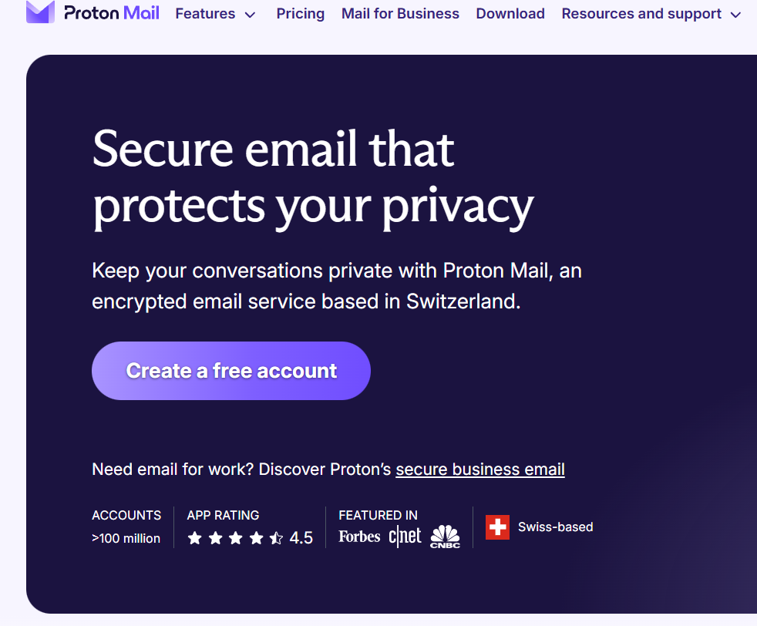
Free secure email account to receive your DOJ Reports.

Slide 9
May 1, 2025
We are here to help you!
Please reach out with any questions along the way.
Notes:
We are asking that all churches become complaint by May 1, 2025

